Slide 1
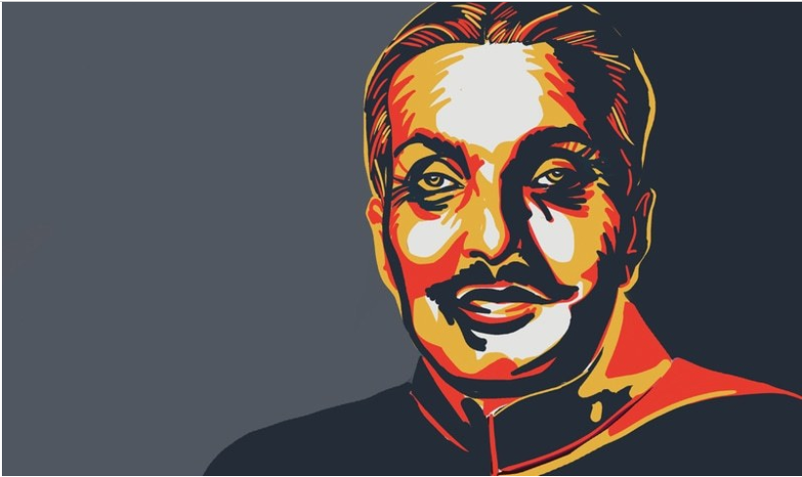
Zia REGIME 1978-88
SYED USMAN IBRAHIM
WALEED IJAZ
TALHA ALAM

Slide 2
General Zia
Born 12 August 1924 – 17 August 1988
Pakistani four-star general
Declared third martial law in Pakistan history 1977.
He was Pakistan's longest-serving head of state.

Slide 3
Background
After deposing Prime Minister Bhutto on 5 July 1977, Zia declared martial law, and appointed himself Chief Martial Law Administrator, which he remained until becoming president on 16 September 1978.

Slide 4
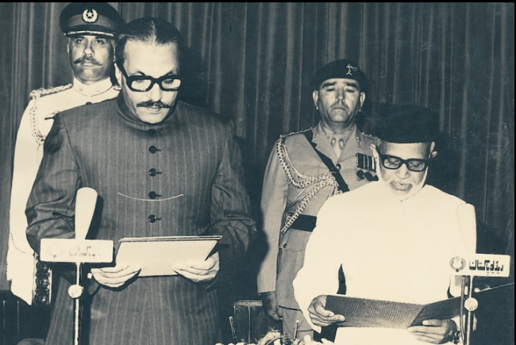
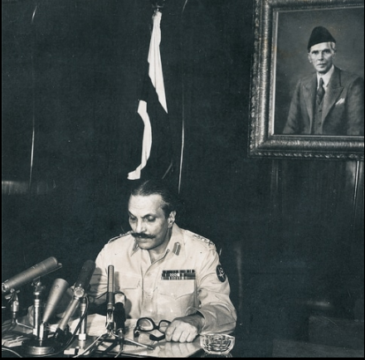
The Reign of General Zia
Reign as Chief Martial Law Administrator
Reign as President of Pakistan

Slide 5
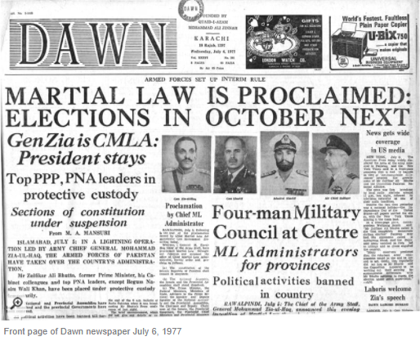
Martial Law under General Zia
Steady economic growth favouring the private sector.
Efforts were made to Islamize the political, legal and economic structures.
Pakistan gained the status of Most Favoured Nation from the United States following the Soviet invasion of Afghanistan in December 1979.
Vast amounts of military equipment and aid were donated to Pakistan to help the four million Afghan refugees who crossed into Baluchistan and North West Frontier Province.
Zulfiqar Ali Bhutto
Trial
The Doctrine of Necessity

Slide 6
Islamization
Majlis-e-Shura
Compulsory Education for Islamiat and pst
Zakat , Ushr
Shariah Court
Law of Evidence
Shariah Council
Nizam-i-Salaat
Interest free banking
Hadood Ordinance
(punishments)
Law of Evidence
Ordinance For Ramzan

Slide 7
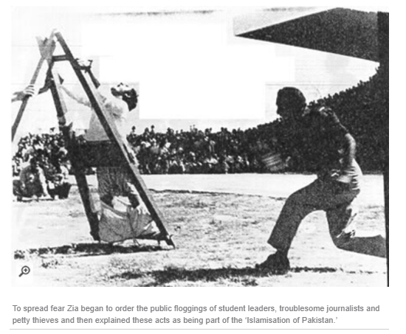

Slide 8
Reign as President of Pakistan
Despite the dismissal of most of the Bhutto government, President Fazal-e-Ilahi Chaudhry was persuaded to continue in office as a figurehead.
After completing his term, and despite Zia's insistence to accept an extension as President, Chaudhry resigned, and Zia took the office of President of Pakistan on 16 September 1978.
Thus his position was cemented as the undisputed ruler of the country. Over the next six years, Zia issued several decrees which amended the constitution and greatly expanded his power.
Most significantly, the Revival of Constitution of 1973 Order granted Zia the power to dissolve the National Assembly virtually at will.

Slide 9
Economic policy
However, between 1977 and 1986, the country experienced an average annual growth in the GNP of 6.8%—the highest in the world at that time—due to remittances from the overseas workers, rather than government policy.
The first year of Zia's government coincided with a dramatic rise in remittances, which totalled $3.2 billion/year for most of the 1980s, accounted for 10 percent of Pakistan's GDP.
45 percent of its current account receipts, and 40 percent of total foreign exchange earnings.
By the end of 1987, the Finance ministry had begun studying the process of engaging the gradual privatisation and economic liberalisation.

Slide 10
Referendum of 1984
After Bhutto's execution, momentum to hold elections began to mount both internationally and within Pakistan. But before handing over power to elected representatives, Zia attempted to secure his position as the head of state.
A referendum was held on 19 December 1984 with the option being to elect or reject the General as the future President, the wording of the referendum making a vote against Zia appear to be a vote against Islam. According to official figures 95% of votes were cast in favour of Zia, however only 10% of the electorate participated in the referendum.

Slide 11
1985 Elections
The election campaign was closely regulated by the military government. The candidates were not allowed to used loudspeaker, hold public meetings or take out processions. The candidates generally shied away from talking about domestic political problems or foreign policy. They focused on local problems and issues. Parochial and ethnic considerations, local alliances and local feuds figured prominently in election campaigning.
The exclusion of political parties and restrictions on political mobilization enabled the feudal and tribal elite to emerge victorious in the polls. The well-known landed families of the Punjab, Sindh, NWFP and the tribal chiefs of Baluchistan tightened their hold over the elected bodies. The commercial elite and the affluent candidates also performed well in the polls.

Slide 12
1985 Elections
Background of National Assembly Members. 1985
Landlords and Tribal leaders 157
Businessmen 54
Urban Professionals 18
Religious Leaders 6
Others 3
TOTAL SEATS 238
Sources: Dawn, Jang and Herald. Cited in, Omer Noman. (Pakistan A Political and Economic History Since 1947)

Slide 13
1985 Elections
The 1985 General Elections: Voters’ Turn-out
National Assembly 52.93%
Provincial Assembly
Punjab 61.80%
Sindh 49.82%
NWFP(Khyber Pakhtunkhwa) 47.61%
Baluchistan 46.62%

Slide 14
1985 constitutional amendments
Zia-ul-Haq thus made many changes in the Constitution before reviving it. The amendment was made immediately after the general elections and before nominating the Prime Minister and prior to the formation of the civilian government. These amendments were based on his constitutional plan which he announced on 12 August 1983. The balance of power had clearly shifted in favor of the President after the RCO and the office of the Prime Minister was relegated to a subservient and subordinate position.
On 10 March, Zia promulgated a new order enforcing all but 27 Articles of the amended Constitution. Twenty-one of the Articles which were left suspended, related to the fundamental right and writ jurisdiction of the High Courts. Also uninformed, was Article 6 which described as high treason punishable under the law. Elections were held to the Senate on 12 March and Pakistan finally had a parliament.

Slide 15
1985 constitutional amendments
The President was given the authority to nominate and appoint the Prime Minister at his discretion from amongst members of the National Assembly. Similarly, the provincial Governors were vested with the power to appoint Chief Ministers of their respective provinces from amongst the members of the Provincial Assemblies
Zia nominated a veteran political from Sindh, Mohammed Khan Junejo, as Prime Minister on 23 March 1985. While handing over power to Junejo and his government, Zia made it clear that it was not a transfer of power from a military to a civilian government. It was at best the sharing of some of the powers by the military with the newly formed civilian government.

Slide 16
1985 constitutional amendments
The Eighth Amendment was a clearly a capitulation on the part of the newly formed civilian government to get lifted martial law. While retaining elements of both the parliamentary and the presidential form of government, the Amendments tilted the balance of latter’s favorite Eight Amendment reduced the status of the Prime Minister, making him subservient to the desires of the former. The main obsessing was to retain power at any cost, even if this meant the negation of constitutional democracy, national integrity and national institution.

Slide 17
Economic policy
The first year of Zia's government coincided with a dramatic rise in remittances, which totalled $3.2 billion/year for most of the 1980s, accounted for 10 percent of Pakistan‘ s GDP.
45 percent of its current account receipts, and 40 percent of total foreign exchange earnings.
By the end of 1987, the Finance ministry had begun studying the process of engaging the gradual privatisation and economic liberalisation.
Fifth Five-Year Plans (1978-1983) was an attempt to stabilise the economy and improve the standard of living of the poorest segment of the population.
Many of the controls on industry were liberalised or abolished, the balance of payments deficit was kept under control, and Pakistan became self-sufficient in all basic foodstuffs with the exception of edible oils.
The sixth five-year plans represented a significant shift toward the private sector. It was designed to tackle some of the major problems of the economy: low investment and savings ratios; low agricultural productivity; heavy reliance on imported energy; and low spending on health and education. The economy grew at the targeted average of 6.5% during the plan period and have exceeded the target if it had not been for severe droughts in 1986 and 1987.

Slide 18
Soviet-Afghan War
On 25 December 1979, the Soviet Union (USSR) intervened in Afghanistan.
International standing enhancement and resumption of aid
Pakistan was offered $325 million in aid over three years by USA, which later was made to $1 billion.
Pakistan got 40 F-16 jet fighters from USA.
Zia played a large part in the eventual withdrawal of Soviet troops from Afghanistan in 1988.

Slide 19
Dismissal of the Junejo government and call for new elections
His era led to serious disturbances in Karachi and ultimately Karachi went into the secular control of MQM from the clutches of Sunnis Jamaat-e-Islami.
Ojhri Camp blast had irreversibly weakened Zia
On 29 May 1988, Zia dissolved the National Assembly and removed the Prime Minister under article 58(2)b of the amended Constitution.
Zia promised to hold elections in 1988 after the dismissal of Junejo government.
He said that he would hold elections within the next 90 days.
Benazir Bhutto had returned from exile in 1986, and had announced that she would be contesting the elections.

Slide 20
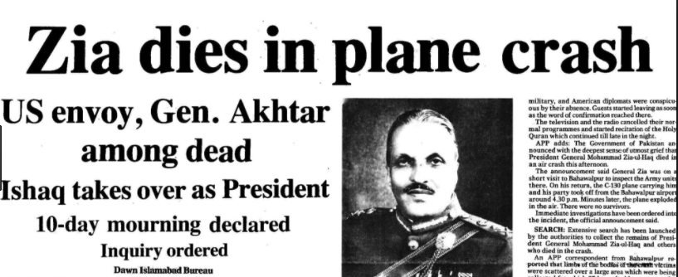
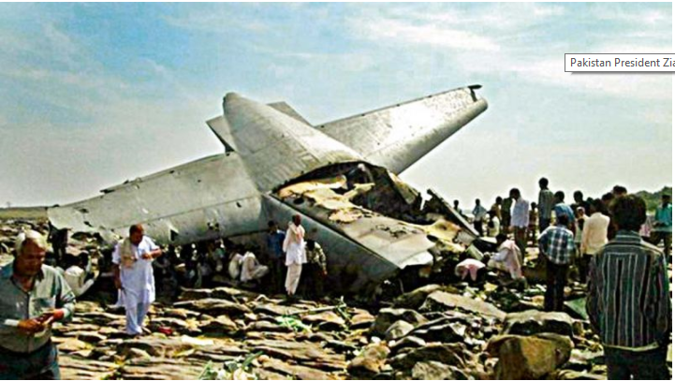

Slide 21
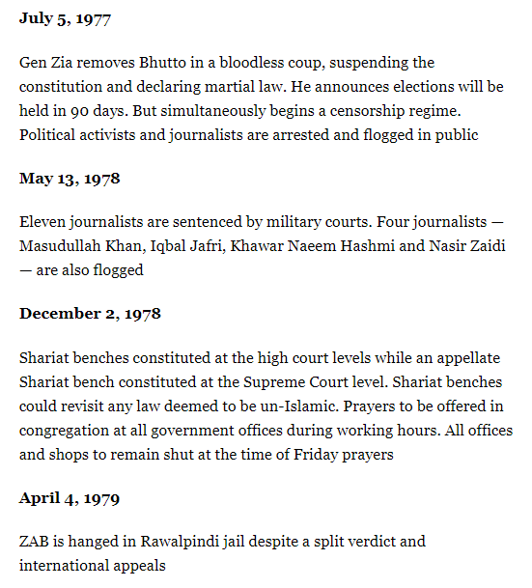
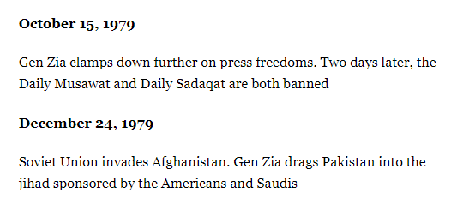
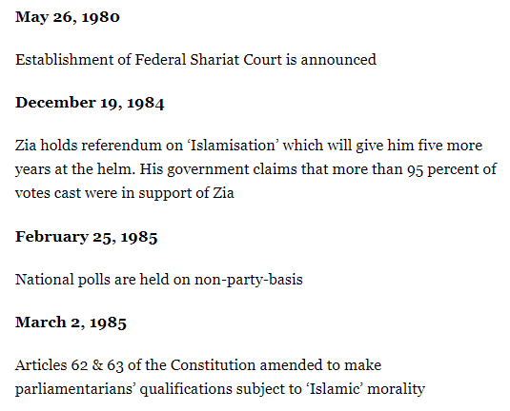
ZIA RULE TIMELINE 1977-88

Slide 22
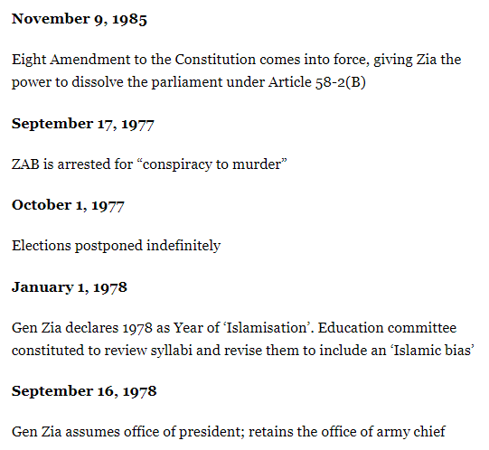
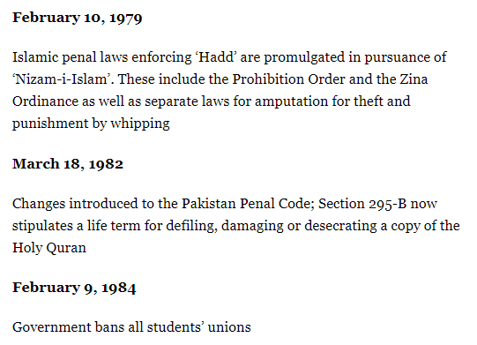

Slide 23
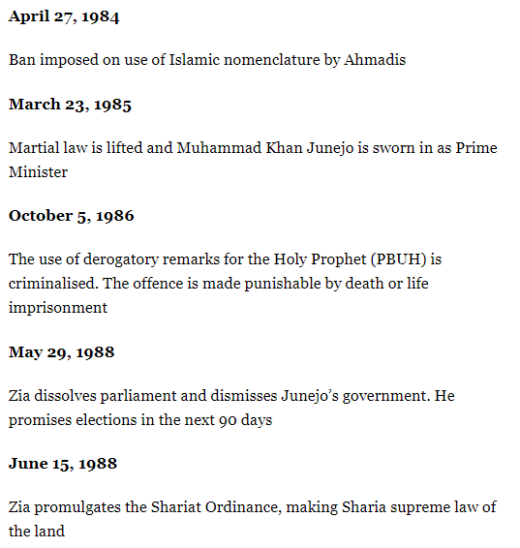
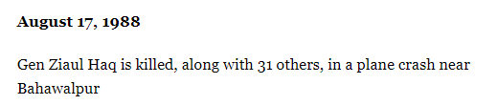

Slide 24
ANY QUESTIONS ?

